Slide 1
LinkedIn + CV Workshop Series
Week 1: Soft vs Technical Skills
"Kendinizi satmadan önce kendinizi tanıyın"
Presented by: Imran Shahriar

Slide 2
Medium of Instruction / Öğretim Dili
Presentation will be given in English
Sunumu İngilizcede verilecektir
If you have question, feel free to ask in English
Sorularınız varsa Türkçede sormaktan çekinmeyiniz

Slide 3
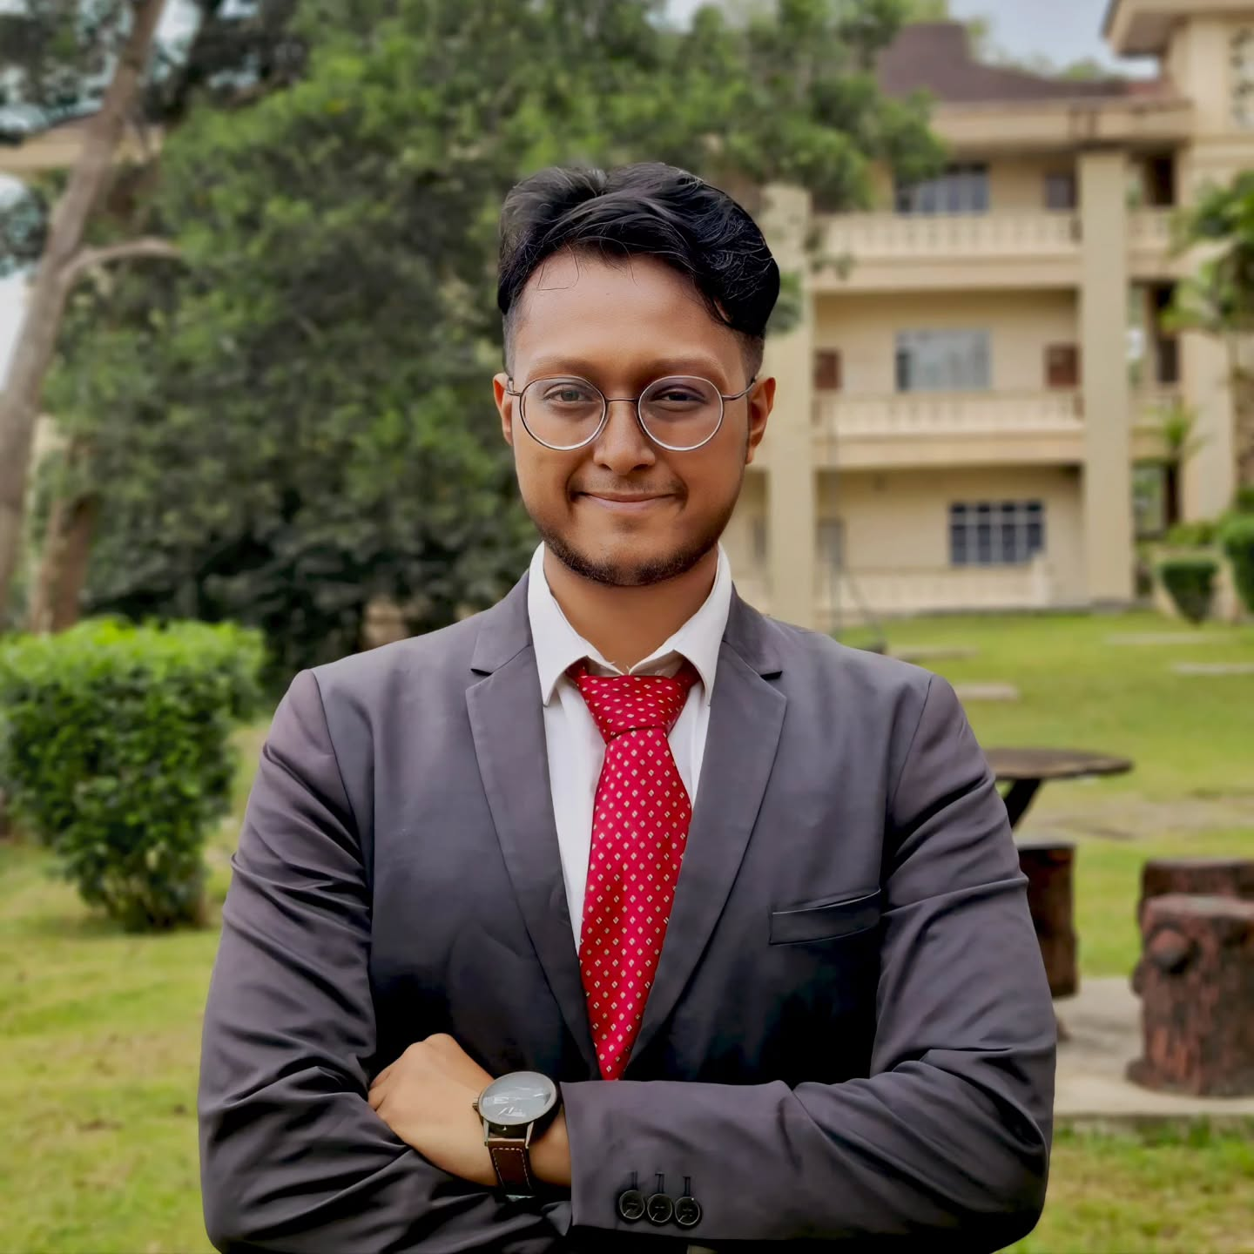
About Me: Imran Shahriar
MSc in Structural Engineering at METU – YTB Merit Scholar
BSc in Civil Engineering at UTM Malaysia
GRE/TOEFL Course Instructor @ PIE Academy
Site Engineer @ M.H. Properties
Chapter Lead @ Google DSC UTM 2022/23
Vice President @ UNESCO UTM 2021/22

Slide 4
Course Overview
Week No. (Thursday 7-8:30PM) | Content
1 (24/04/2025) | Soft Skills vs Hard Skills
2 (08/05/2025) | CV/Resume
3 (15/05/2025) | LinkedIn
4 (22/05/2025) | Building Online Personal Branding
5 (29/05/2025) | Acing Job Applications & Interviews

Slide 5
Today’s Goals
Understand the difference between soft and technical skills
Reflect on your own strengths
Learn how to express your skills clearly on CVs and LinkedIn
Set the stage for personal branding

Slide 6
Icebreaker Prompt
If you could be hired tomorrow for your dream job, what would it be?
One-sentence answers from participants

Slide 7

Technical Skills
Measurable and teachable abilities
Often learned through coursework, certifications, or experience
Examples
Programming
Excel
CAD
Data analysis
Lab techniques

Slide 8

Soft Skills
Personal attributes that influence how you work with others
Developed over time through experience and challenges
Examples:
Communication
Leadership
Teamwork
Adaptability
Time management

Slide 9

Soft + Technical = Career Success
Technical skills help you get the job
Soft skills help you keep it and grow
Recruiters often assume your technical skills, but remember your soft skills

Slide 10


Map Your Skills
Skill
Where You Learned It
Where You Used It
What Resulted
Excel
University course
Internship
Automated reporting process

Slide 11
My Hard/Technical Skills
Skill | Where You Learned It | Where You Used It | What Resulted
Python | Self-learning + Google Workshops | SHM app, ML pipelines, data preprocessing | Built real-time SHM discomfort alert tool; ML model for anomaly detection
Django + React | Self-taught + GDSC workshops | Built frontend/backend for SHM app | Published prototype for discomfort modeling based on ISO guidelines
AutoCAD & Revit | UTM coursework + internships | Site design and BIM modeling during M.H. Properties internship | Created full-scale 9-storey layout and structural drawing sets
TensorFlow & ML | Google courses + thesis research | Time-series anomaly detection in SHM sensor data | Built autoencoder and outlier detection models for discomfort prediction
SQL + Streamlit | Self-learning during app development | Web-based discomfort visualization tool | Enabled user-driven dashboards for live data monitoring in buildings

Slide 12
My Soft Skills
Skill | Where You Learned It | Where You Used It | What Resulted
Leadership | Google DSC Lead, UNESCO UTM VP, peer tutoring roles | Led workshops and GDSC events for 100+ students | Built UTM’s tech-community culture, trained peers in coding and engineering tools
Communication | GRE/IELTS teaching, public speaking | Blog posts, conference paper presentations, interviews | Developed persuasive SoPs, built international visibility
Resilience (Sabr) | Job setbacks, funding rejections | Re-strategized after denied MSc/PhD rounds in US application | Pivoted to METU YTB and worked on research skills
Cross-cultural teamwork | UNESCO UTM, GDSC UTM, YTB | Collaborated with local and international teams in Türkiye, Malaysia, Bangladesh | Delivered outcomes across language and academic barriers, like our session today
Mentorship & Teaching | IELTS/GRE teaching, university events | Taught GRE, TOEFL, structural mechanics, coding, engineering tools | Helped students improve scores, advise students, conduct workshops

Slide 13

Your Skills Brainstorm
Write down 3 technical skills you have
1
Write down 3 soft skills you’re proud of
2
Share one of each with the group or a neighbour
3

Slide 14
2-Sentence Skill Pitch
Pick 1 skill and explain it in 2 sentences
You will share
Clarity, impact, and relevance

Slide 15
Don’t List Skills, Show Them!
Use STAR format: Situation, Task, Action, Result (Week 2)
Start with action verbs: Led, Built, Designed, Managed
Example: 'Led a team of 3 to build a mobile app in Python, reducing workload by 40%'

Slide 16
Wrap-Up & Homework
Soft and technical skills go hand-in-hand
Homework:
Your list of hard skills and soft skills based on our format
Next week’s session:
Writing CVs and Resume

Slide 17
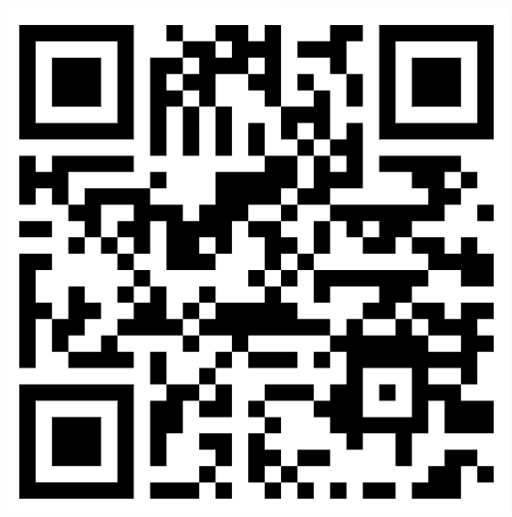
Let’s Connect

